Slide 1
A STUDY ON MULTI-ROBOT SYSTEMS IN STRUCTURED ENVIRONMENTS 18/04/2017
Major Project Review
-HARIKRISHNAN RADHAKRISHNAN (13ME230)
AKSHAY KUMAR V (13ME208)
AMEY S KULKARNI (13ME212)
ADITYA R B (13ME108)

Slide 2
Contents
Objective
Introduction
Literature Review
Kinematic model of differential drive
Multi Robot Simulator- Simulation in MATLAB
Algorithm implementation
Results and Discussion
Conclusion

Slide 3
1. Objective
Develop an algorithm for successful navigation and control of a multi-robot system.
Achieve localization through sensor fusion.
Demonstrate obstacle detection, path planning and system architecture.
Carry out a simulation of the algorithm to test and correct the algorithms.
Design and fabricate the mobile robots.
Implement the algorithm on the fabricated robots.

Slide 4
2. Introduction
Multi-Robot System can be characterized as a set of robots operating in the same environment- inspired by swarm of bees and ant colony.
Multi Robot systems are classified into –
Cooperation level
Knowledge level
Coordination level
Organization level

Slide 5
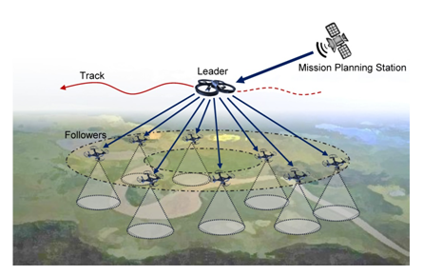
Taxonomy of Multi-Robot systems

Slide 6
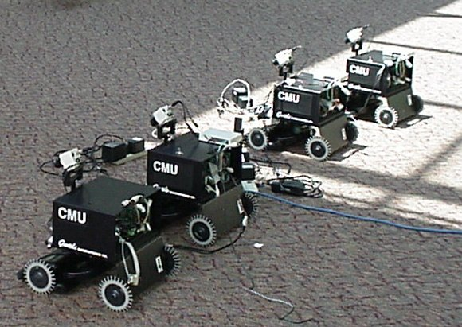
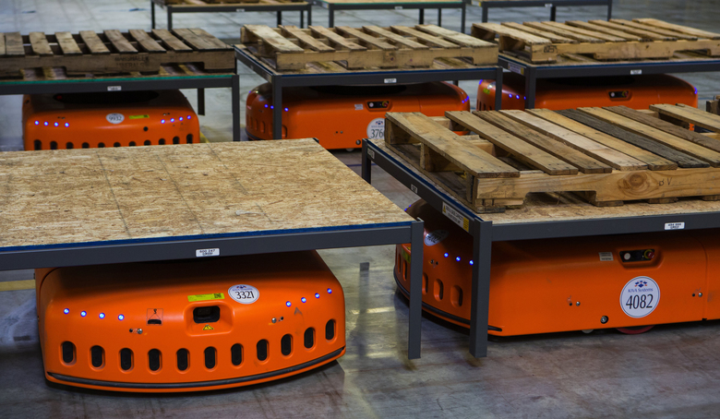
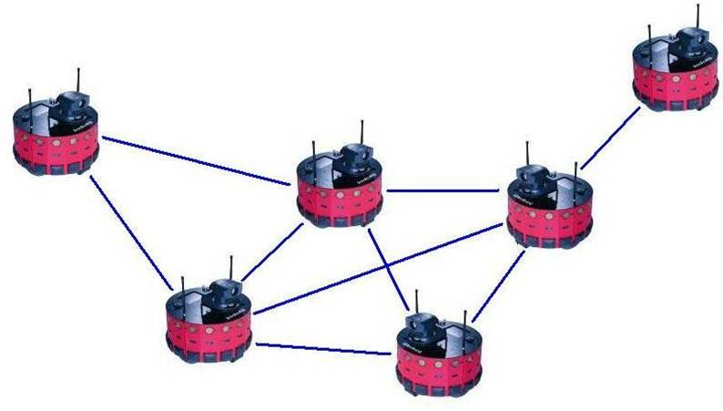
Domains of Relevance and practical applications of Multi Robot Systems
Foraging and coverage
Multi Target Observation
Exploration and Flocking

Slide 7
3. Literature Review
Task Planning, Architecture and Control
Localization and Sensor Fusion
Obstacle Avoidance
Path Planning
Communication and Robot Sensor Network

Slide 8
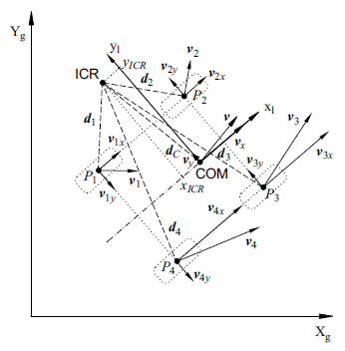
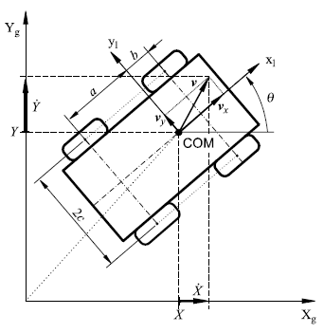
4. Kinematic model of Differential Drive of Robots

Slide 9
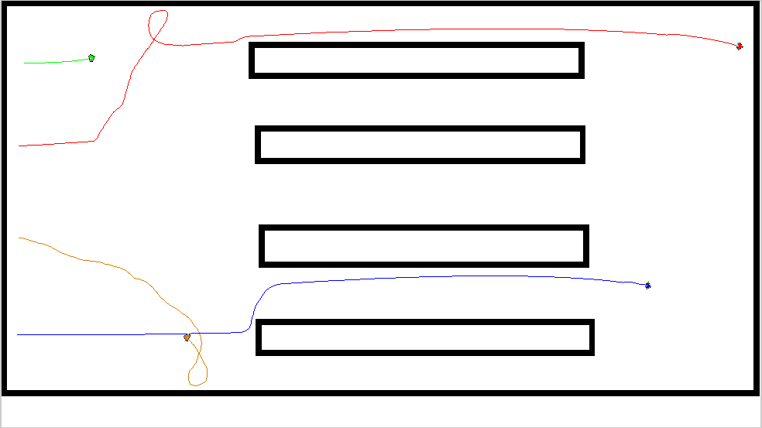
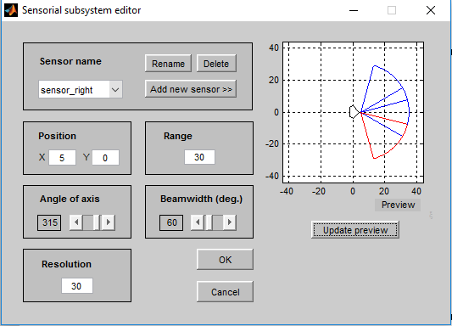
5. Multi Robot Simulator Simulation in MATLAB

Slide 10
Multi Robot Simulator Simulation in MATLAB
Two wheel differential drive robots having 2 DOF are assumed.
The simulation implements the following features which are essential for the multiple robots
Kinematic model for differential drive
Structured map of the environment
Path planning
Task allocation

Slide 11
Robot Hardware Design
Components
Arduino Mega Microcontroller (1).
Infra-red Emitter-Detector IC (3).
L293D Motor Driver IC (1).
Xbee Transciever + Adapter (1).
MOC7811 Optical Encoder (2).
MPU9250 Inertial Measurement Unit [Accelerometer+Gyroscope] (1).
1000mAh 3S 30C/60C Lithium polymer(Lipo) battery Pack (1)
BO 100RPM Motors + Wheels (2).

Slide 12
Robot hardware design
The chassis design for the robot was an iterative process. The final pentagonal design facilitates easy mounting of IR sensors in the front of the robot and helps in making the code for obstacle avoidance easier.
Material Used : Plexiglas acrylic sheet (Poly methyl methacrylate).
Choice of Material • It is easily machinable. • It is strong, tough and light in weight. • It is shatter-resistant.
Manufacturing Process: Laser Cutting.
The design is easily adaptable to new components, hence these design ergonomics make the robots an amateur development kit to explore multi-robot research further

Slide 13
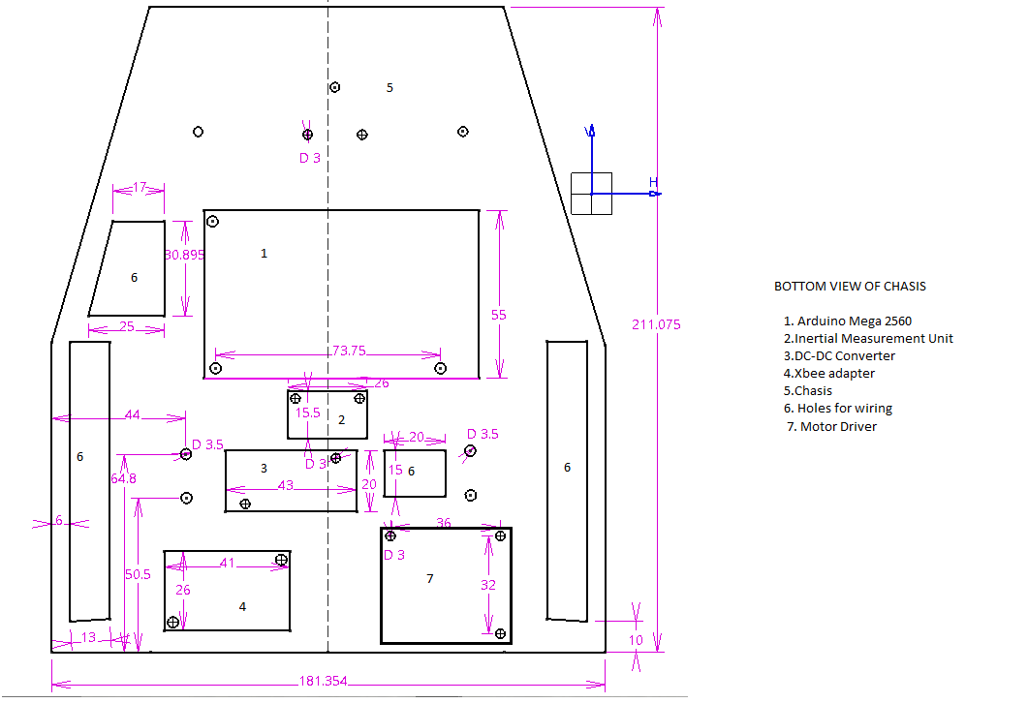

Slide 14
Experimental Setup
The Setup consisted of 3 identical robots that are identical in both hardware and software aspects.
Server Side Machine: Core i7 Quad Core, Ubuntu 14.04
Communication: All the robots and the server machine is equipped with an Xbee Transceiver.
Mapping paradigm: A grid based paradigm was choosen to simplify the path planning process
Path planning algorithm: Depth first search Algorithm was used to find the shortest path in a given map, with least computational complexity.

Slide 15
6. Algorithm implementation-PATH PLANNING
An initial point and a goal is chosen.
A python script was written to find the shortest distance path(least number of grids encountered) to the goal from the initial point using Dijkstra’s algorithm.

Slide 16
Algorithm implementation-TASK ALLOCATION
Random allocation of goals
The goal destination for each robot is allocated randomly by the computer or the user. This goal will not necessarily be nearest goal.
Nearest goals assigned to each robot
Using the Dijkstra’s algorithm, the nearest goals to each robot were found and assigned.
This improved the time of the task and battery usage is reduced.

Slide 17
Algorithm implementation-YAW CORRECTION
1. Encoder correction
The values of two encoders on each robot is compared and if they are not equal, a proportional controller is used to control the speed of wheels so that the robot moves steadily in the given direction.
2. IMU usage
The magnetometer of the IMU is used to find the degree turn of each robot and this is compared to the encoder yaw detected.

Slide 18
7. Results and Discussions-Single Robot Performance
Adjacent is the map generated to test all the robots.
The symbol '+' indicates the generated path. 'S' and 'E' are the starting and end point respectively. The symbol # represents the obstacles in the map.
Each robot is given the same map and same path to test the motion and efficiency of each robot.

Slide 19
Single Robot Performance
Each robot is used to move along the same path in the map and their motion is analysed. The following graph shows the deviation from target of the Robot alpha.

Slide 20
Single Robot Performance

Slide 21
Single Robot Performance

Slide 22
Single Robot Performance

Slide 23
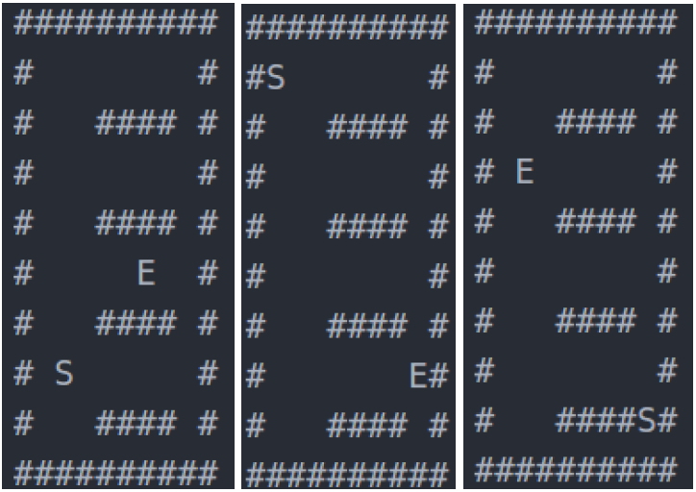
Multi Robot Performance
Initially the goals were assigned manually to each robot. Following are maps for alpha, beta and gamma robots respectively.
The robots simultaneously moved to their goals location in 119 seconds.

Slide 24
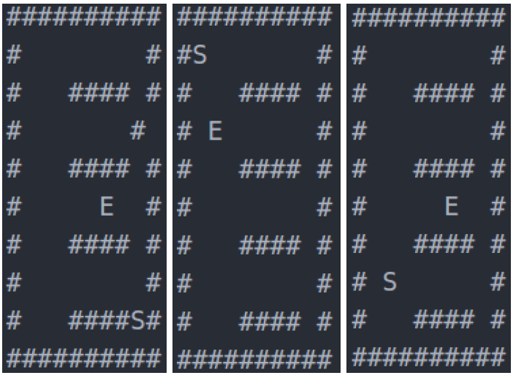
Multi Robot Performance
In the second attempt, Dijkstras’s algorithm was used to assign the nearest goal to the each robot. Following are maps for alpha, beta and gamma robots respectively.
The total time taken for all the robots to reach the nearest calculated destination was 70 seconds.

Slide 25
Multi Robot Performance-IMU Yaw Correction
The following are the IMU values when the robot is stationary. The values are erratic and we need to stabilise them.

Slide 26
Multi Robot Performance-IMU Yaw Correction
A moving average filter was used to stabilise the erratic IMU yaw values so that they can be used.

Slide 27
7. Conclusion
Algorithms were designed for map design, path planning, obstacle detection and task allocation to successfully control the navigation of the robot in a known environment.
Simulation was carried out to test and correct the designed algorithms.
Three identical differentially driven robots having the features of simulated robots were fabricated and all the algorithms were implemented on them.

Slide 28
7. Conclusion
Control of movement of robot is done using Inertial Measurement Unit and encoders. Proportional controller was used on the encoder values to stabilise the motion of robots.
Communication was facilitated using zigbee modules and a centralised system architecture was followed.
The task allocation algorithms made the multi robot system more efficient by choosing the nearest goal for each robot.

Slide 29


